Slide 1


Cloning and working in a Repository

Slide 2

Agenda
Accepting a Github Classroom assignment
Cloning a Repository
Opening that repository in the terminal and installing its dependencies
How to check branches’ names
Committing and pushing changes

Slide 3
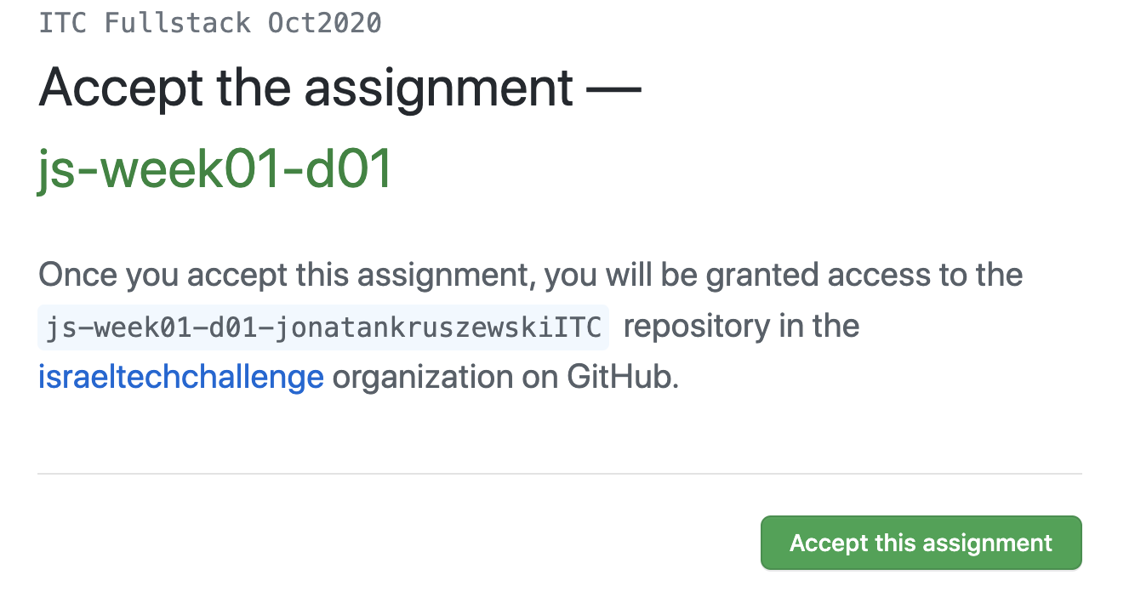
Accepting a Github Classroom assignment
Accept the assignment:

Slide 4
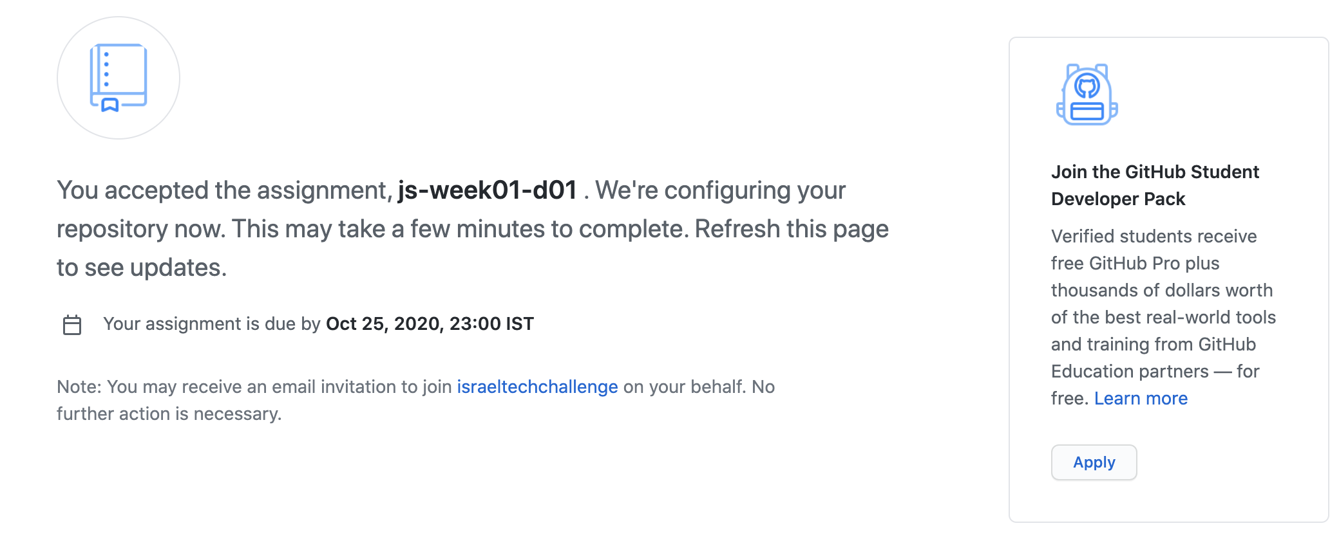
Accepting a Github Classroom assignment
Wait for it a little bit and refresh

Slide 5
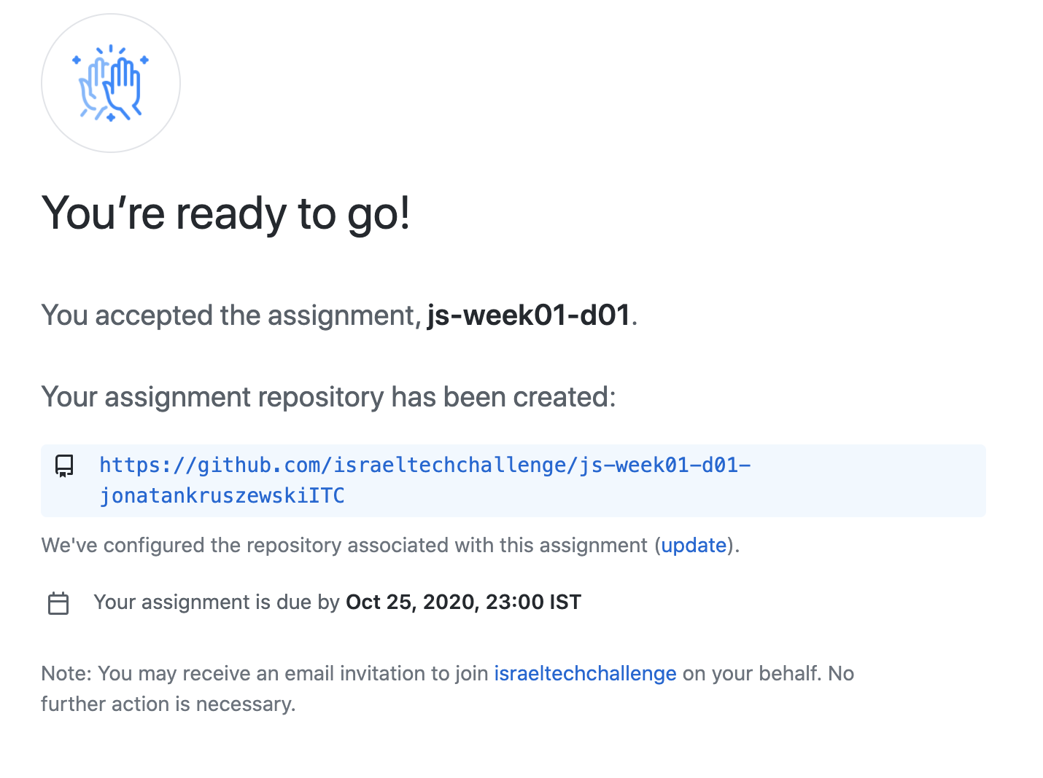
Accepting a Github Classroom assignment
👈 Once it finished, go to the address

Slide 6
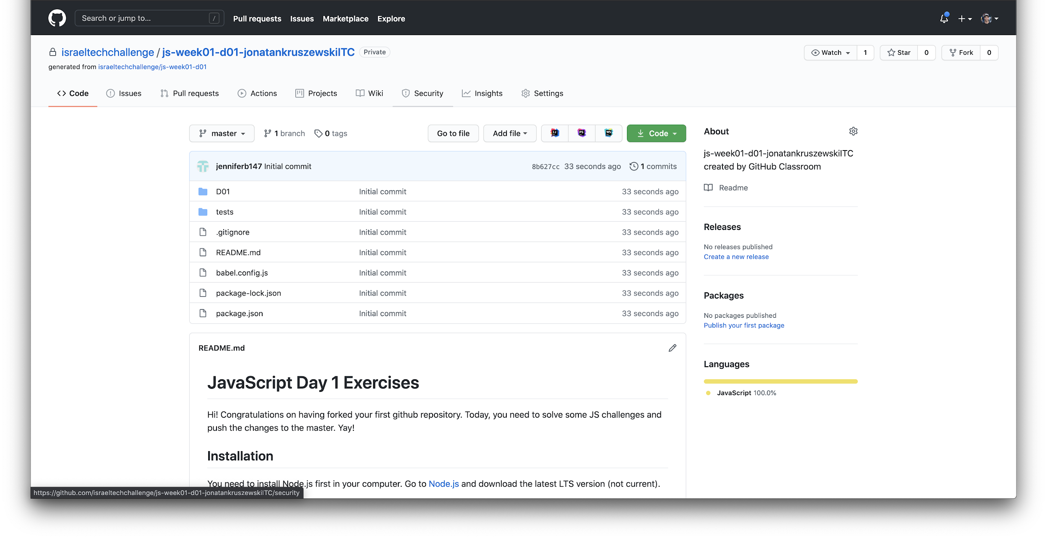
Cloning a Repository
👇 Expand

Slide 7
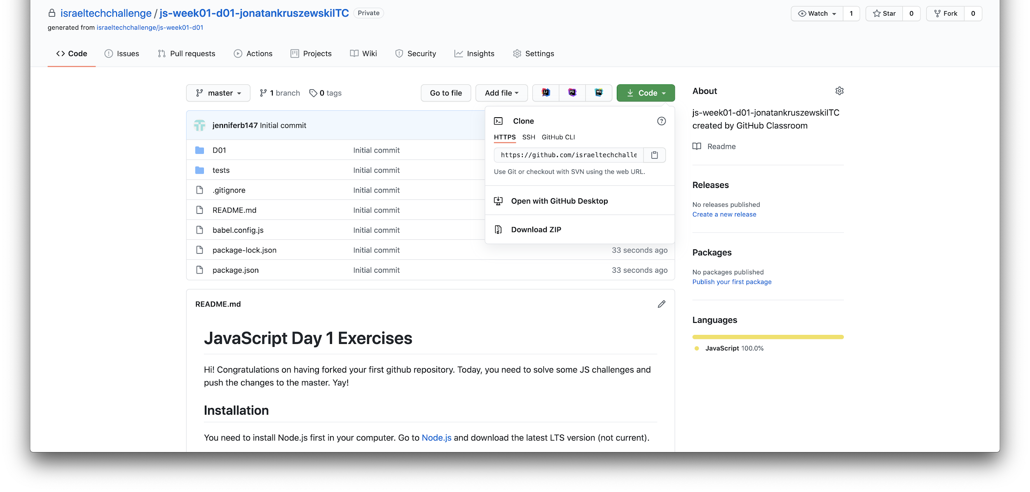
Cloning a Repository
👉
If you had set SSH keys in your PC go with it (we have a guide for it). If not, use HTTPS.
Copy that link.

Slide 8
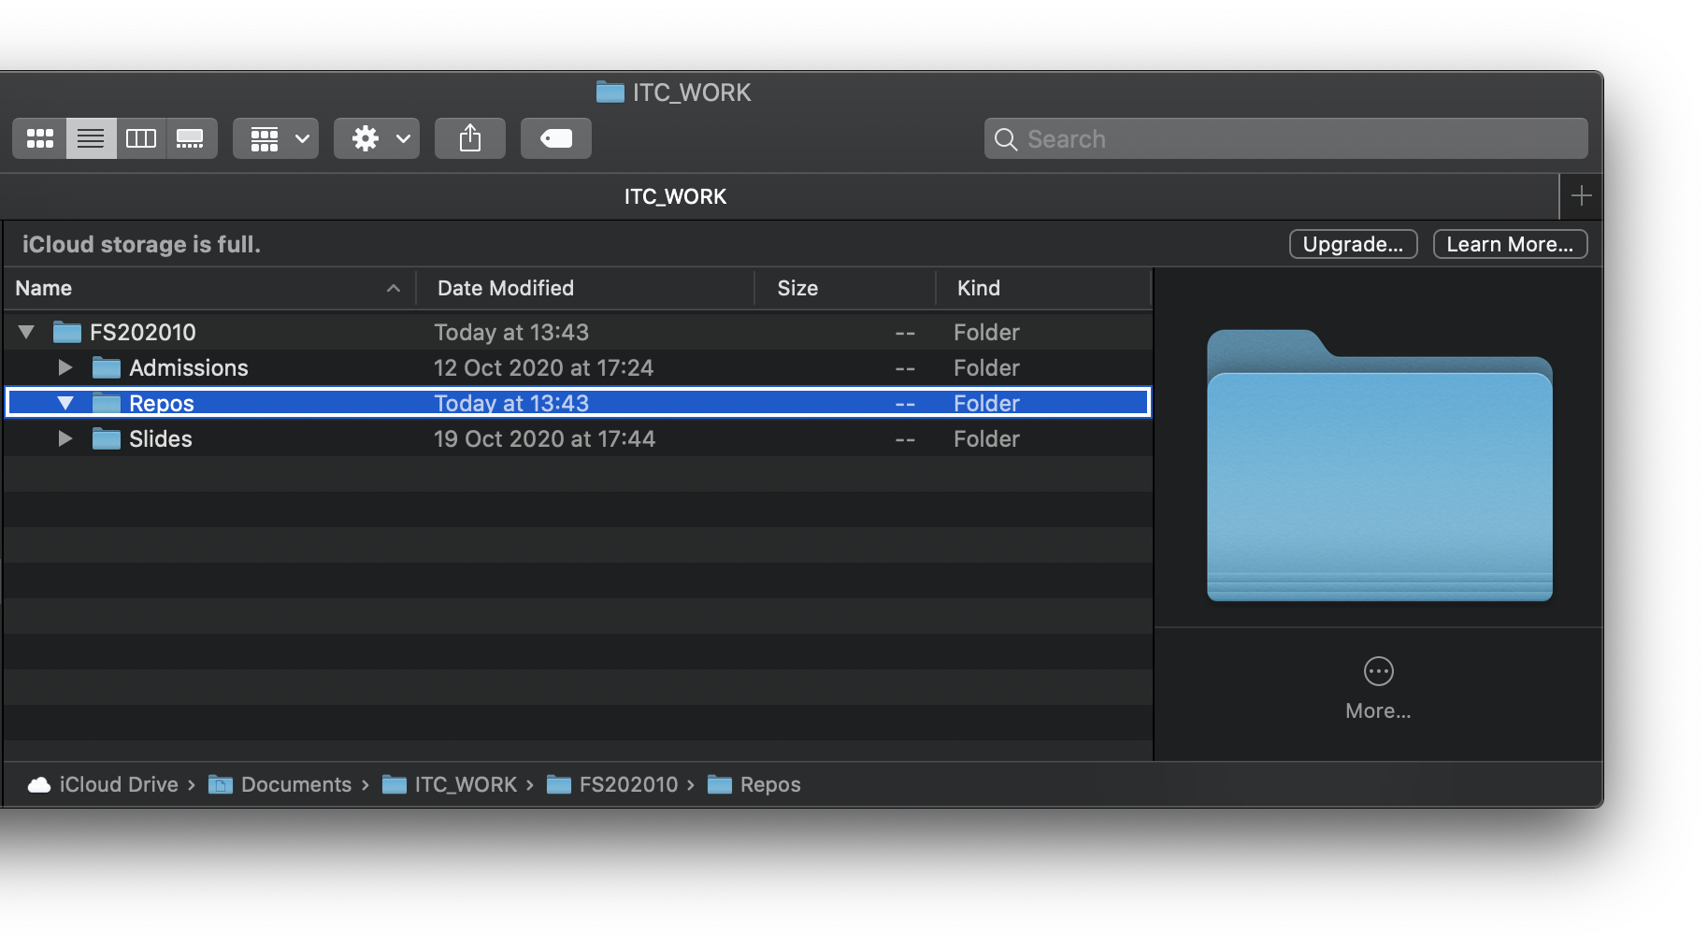
Cloning a Repository
MAC: In your PC, navigate to the location where you would like to clone that repository. In this case, it is under Documents>ITC_WORK> FS202010>Repos
👆Right click and “New terminal at Folder”

Slide 9
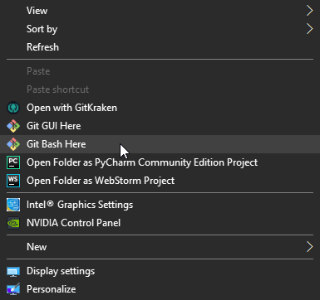
Cloning a Repository
Windows: In your PC, navigate to the location where you would like to clone that repository. Once you got there in the file explorer, right click at any place and select “git bash here”
👆

Slide 10
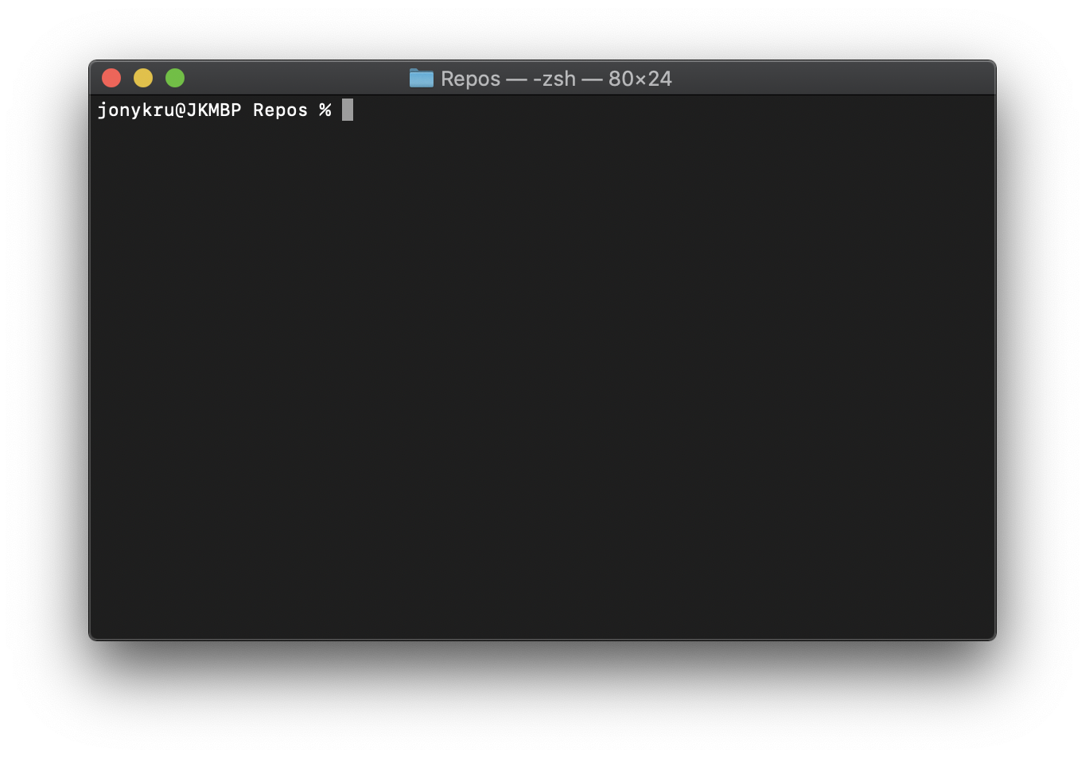
Cloning a Repository
It will open a new Terminal Window at that location.

Slide 11
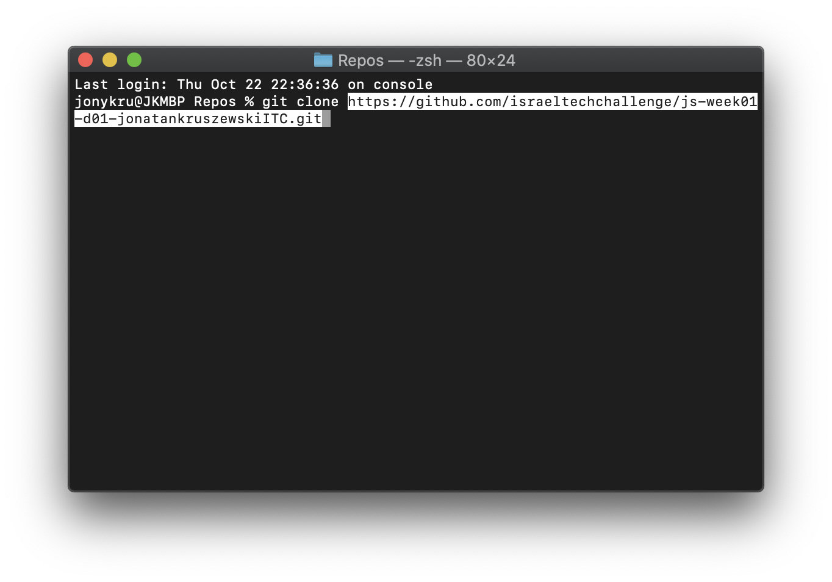
Cloning a Repository
Input:
git clone <repo_adress>

Slide 12
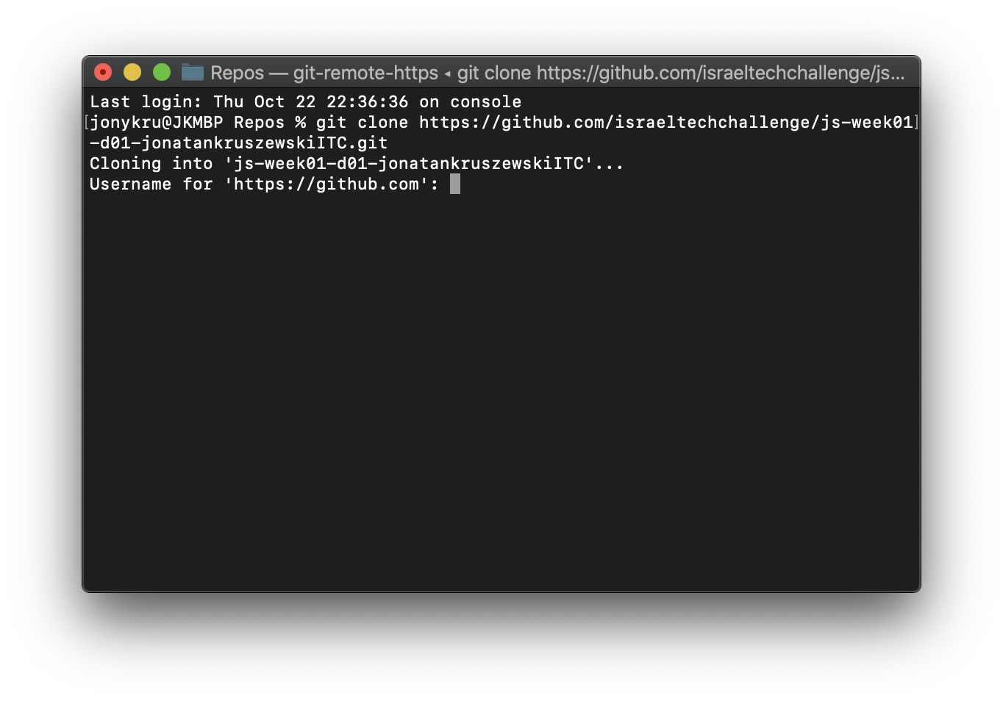
Cloning a Repository
If you are using HTTP, enter your credentials:

Slide 13
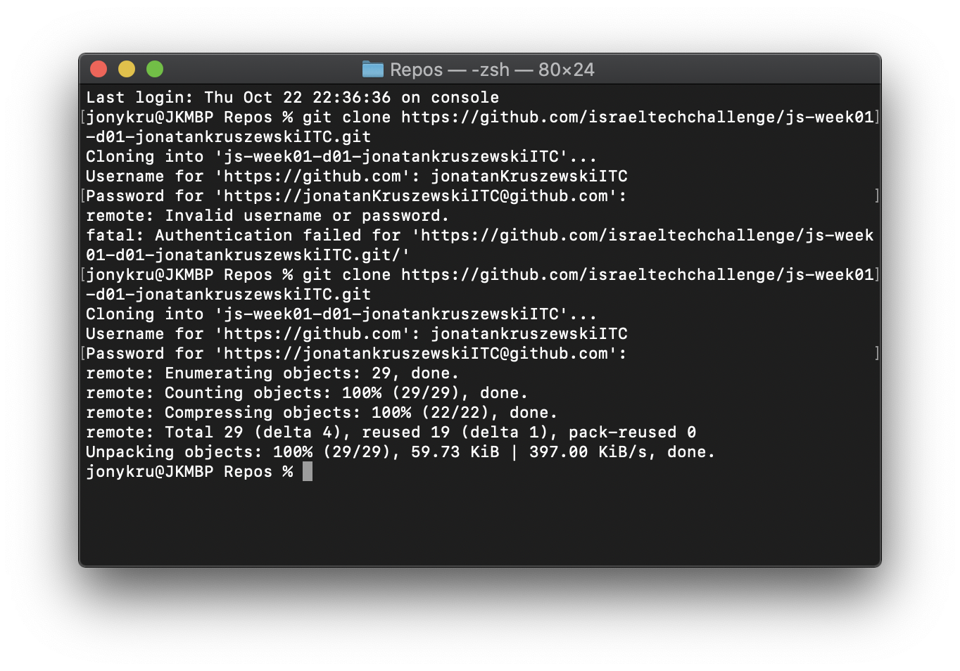
Cloning a Repository
After entering your credentials properly (hopefully after the first attempt) you should see some messages like the ones beneath:

Slide 14
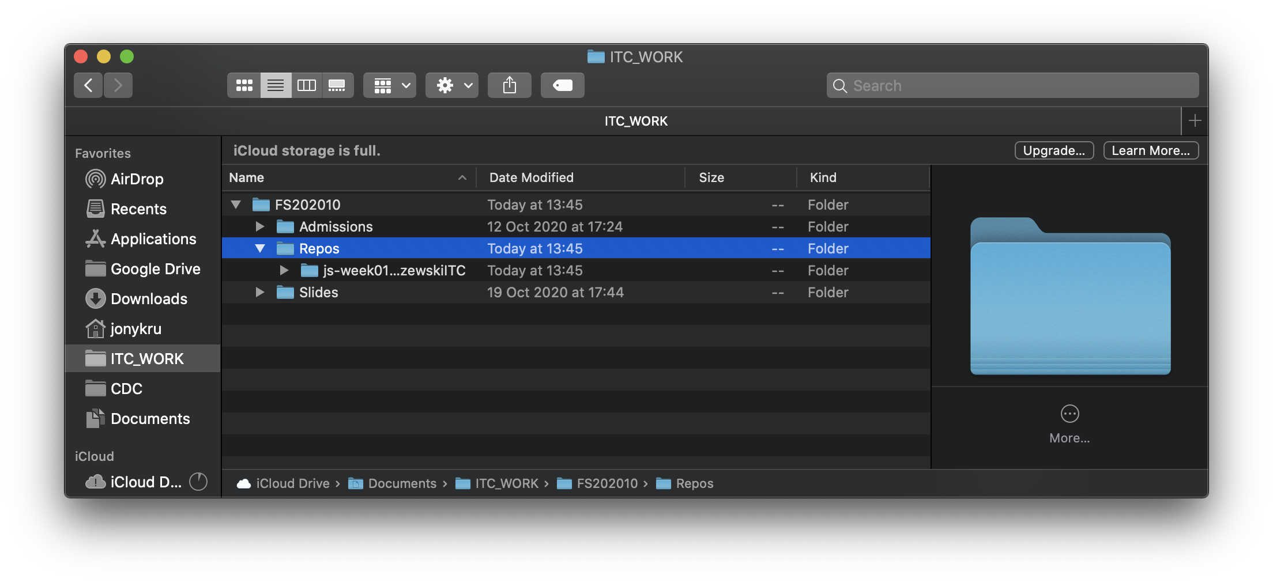
Cloning a Repository
If you check in your file explorer (Finder / Windows) you should see it:

Slide 15
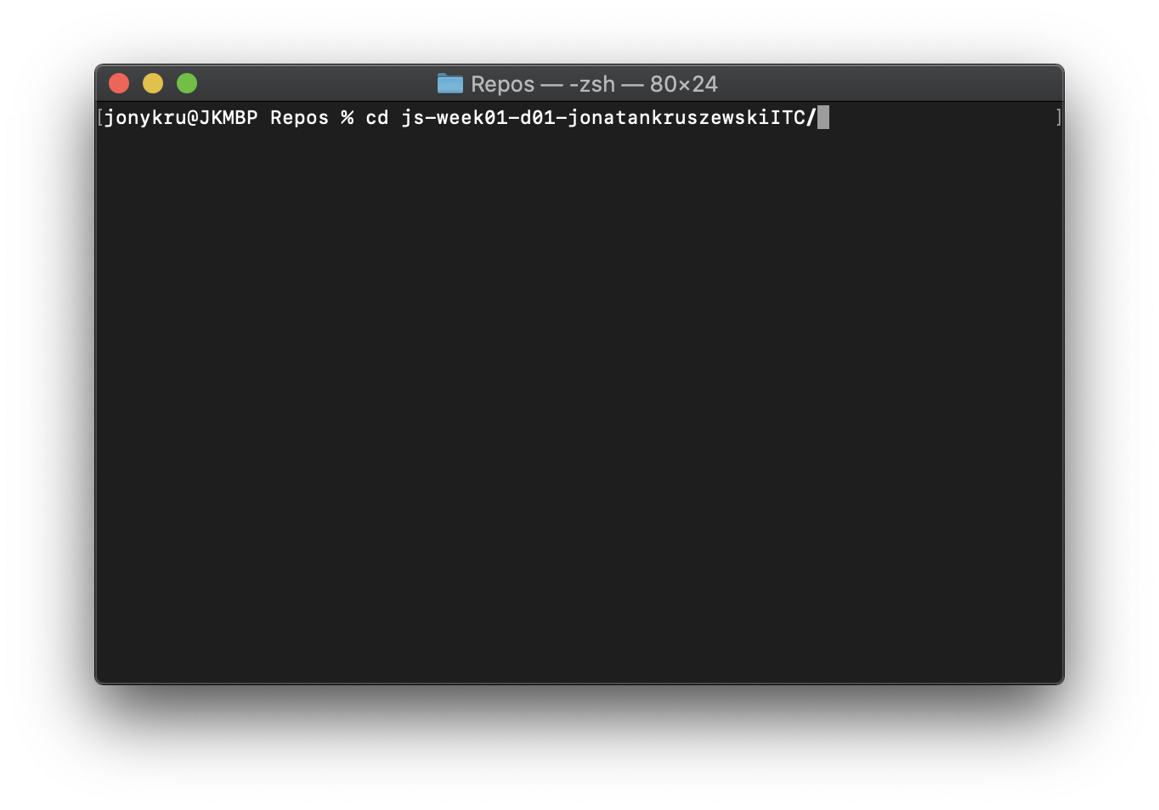
Working in that repository
Open that folder in the terminal. You can do it by using cd <name of the folder> if you are still on the same terminal, or just opening a new terminal window at that location.

Slide 16
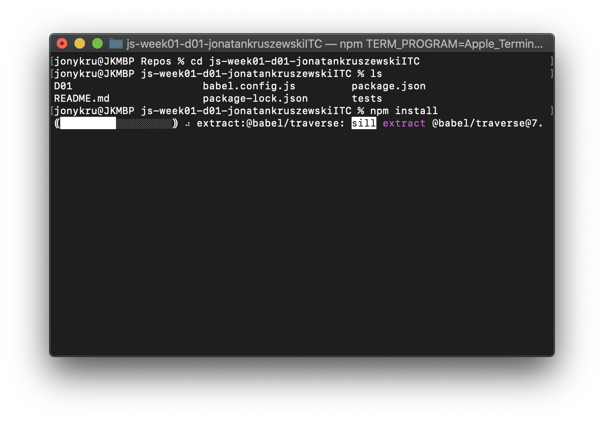
Installing repositories’ dependencies
Input:
ls
If you find that there is a file named:
package.json
It means it is a NodeJs Project and you should install it dependencies.

Slide 17
Installing repositories’ dependencies
Assuming you have NodeJS installed, type:
npm install
Wait for it to finish.
Might not show a graph on some terminals.
Could take 2~3 minutes (or more) easily if the internet connection is not that fast.

Slide 18
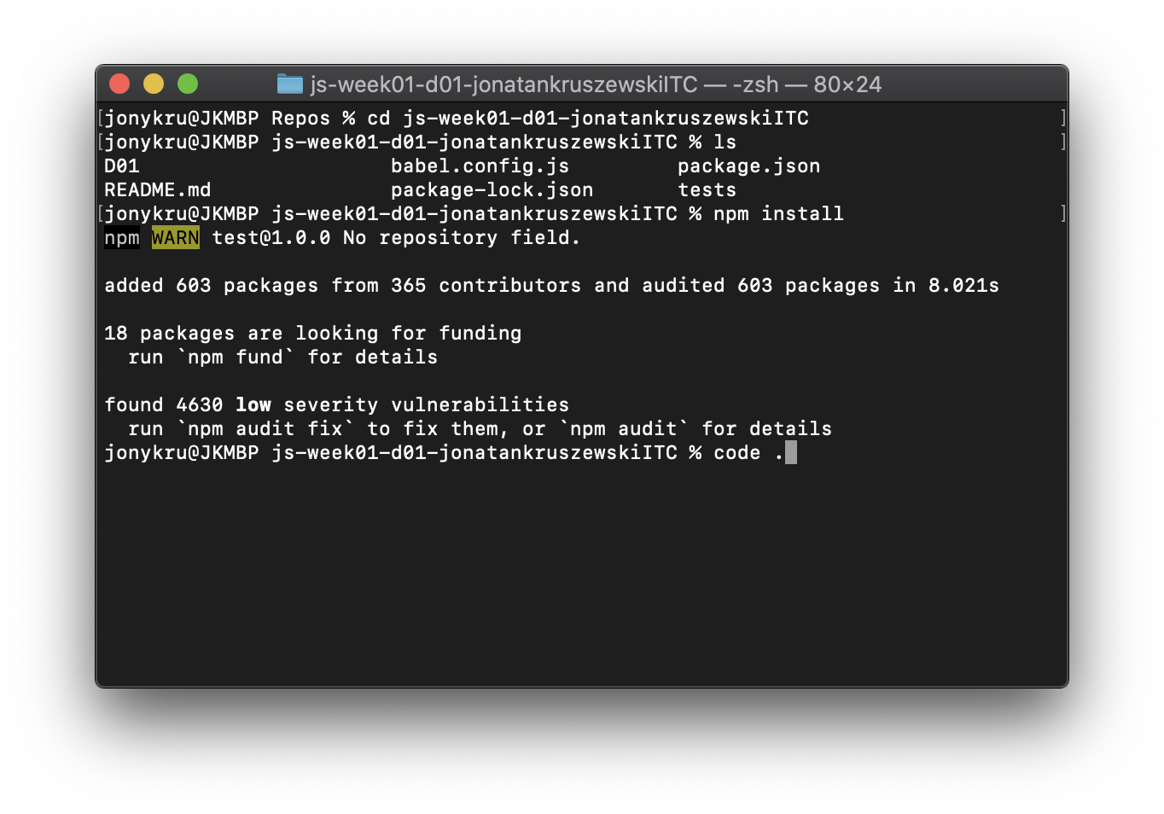
Starting to work
Once finished, you should see some messages that some packages were added.
To open in VSC type
code .
Note for Mac users: You might need to set it up:
https://code.visualstudio.com/docs/setup/mac

Slide 19
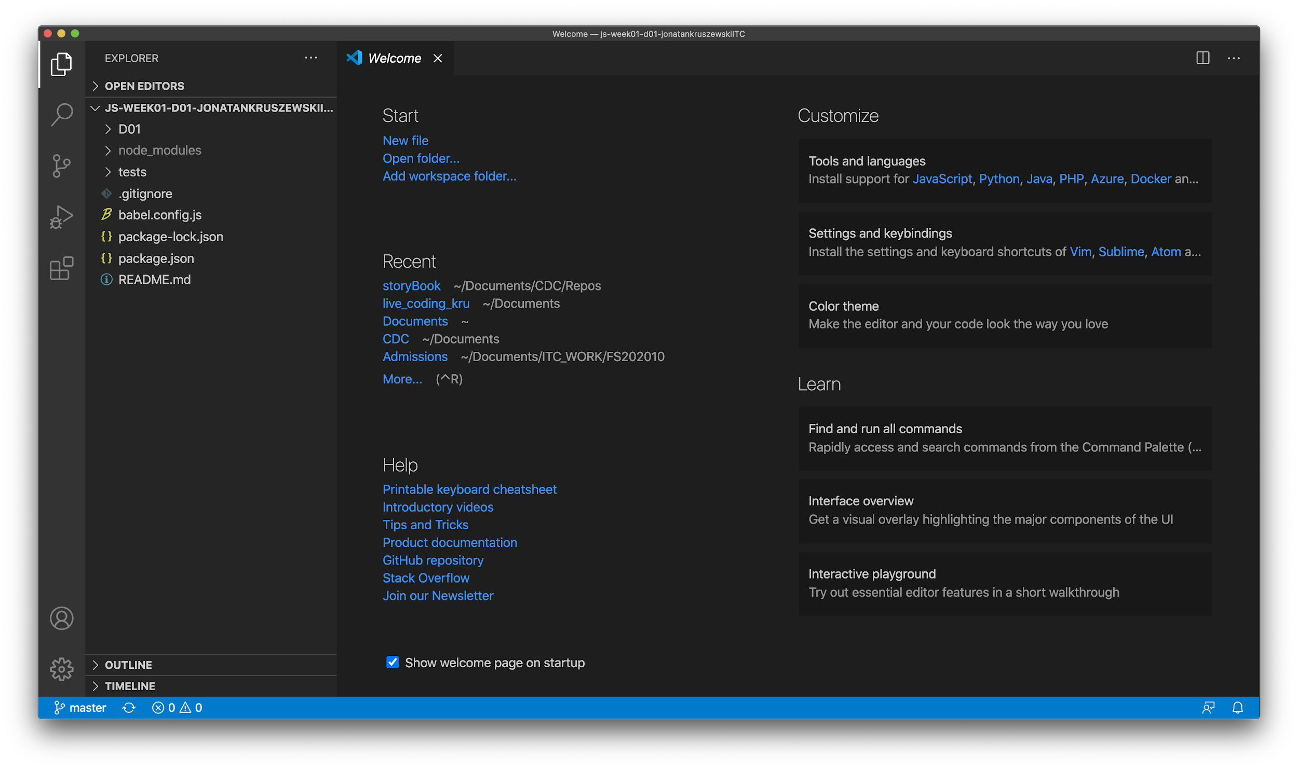
Starting to work
Before commiting, let’s check how our branches are called.
Since 2020 changes has been made to use the term ‘main’ instead of master, but some repositories still use the second one.
It is important to know so we can know to which branch to push to

Slide 20
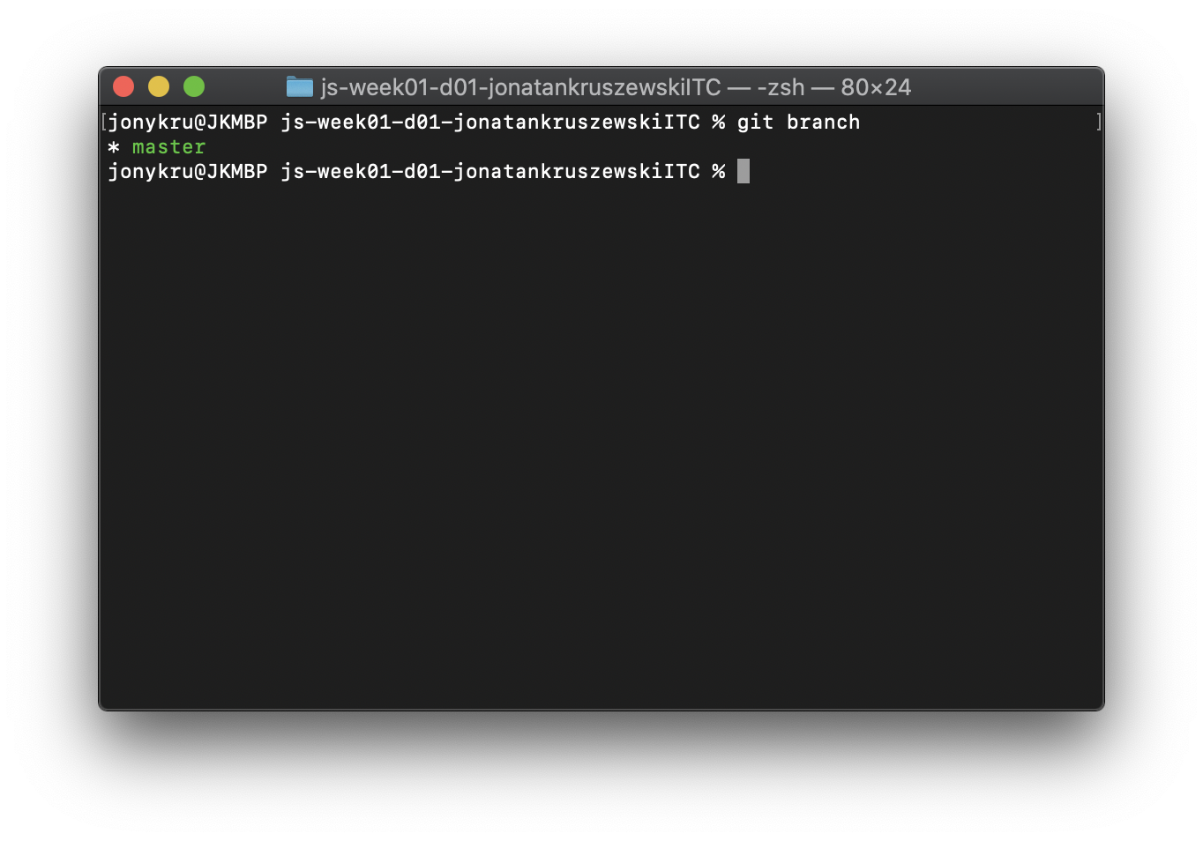
Checking branches’ names
In the repository folder input:
git branch
To check how your local branch is named.
git remote show
git remote show <remote_name>
Let’s check also the remotes branches’ names:

Slide 21
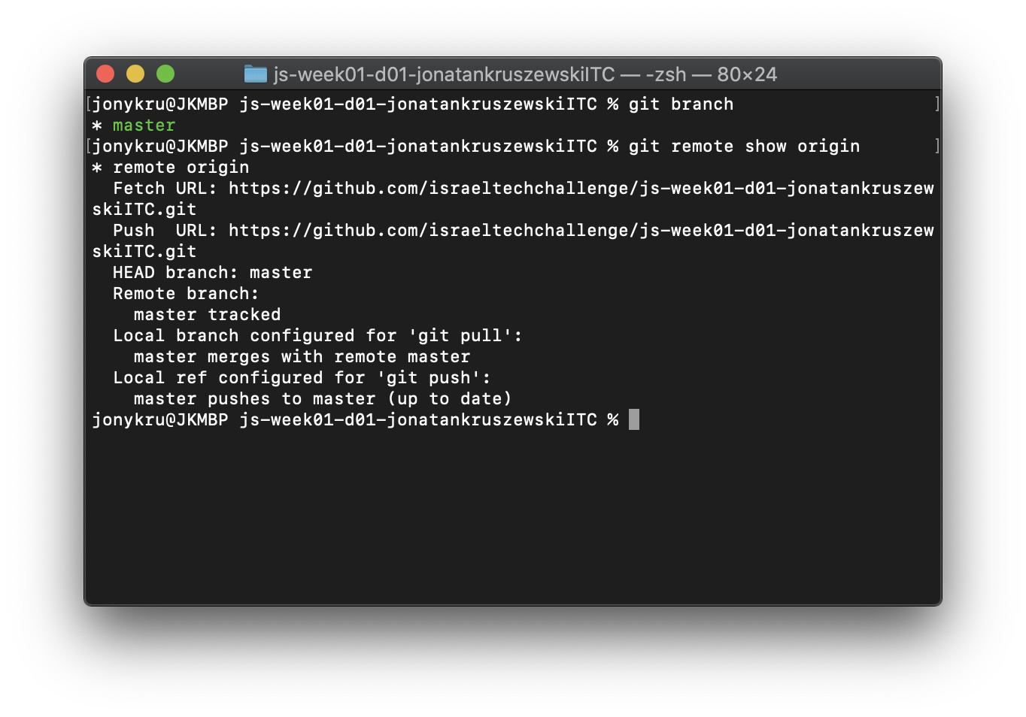
Checking branches’ names
In this case, this repository uses ‘master’ for the remote branch.

Slide 22
Committing and pushing
Now that we know the names of our branches, every time that we would like to push the code we can do:
git add .
git commit -m “<some_message>”
And then, to push to the remote:
git push <name_of_remote> <name_of_branch>
Which in this case would be:
git push origin master

Slide 23
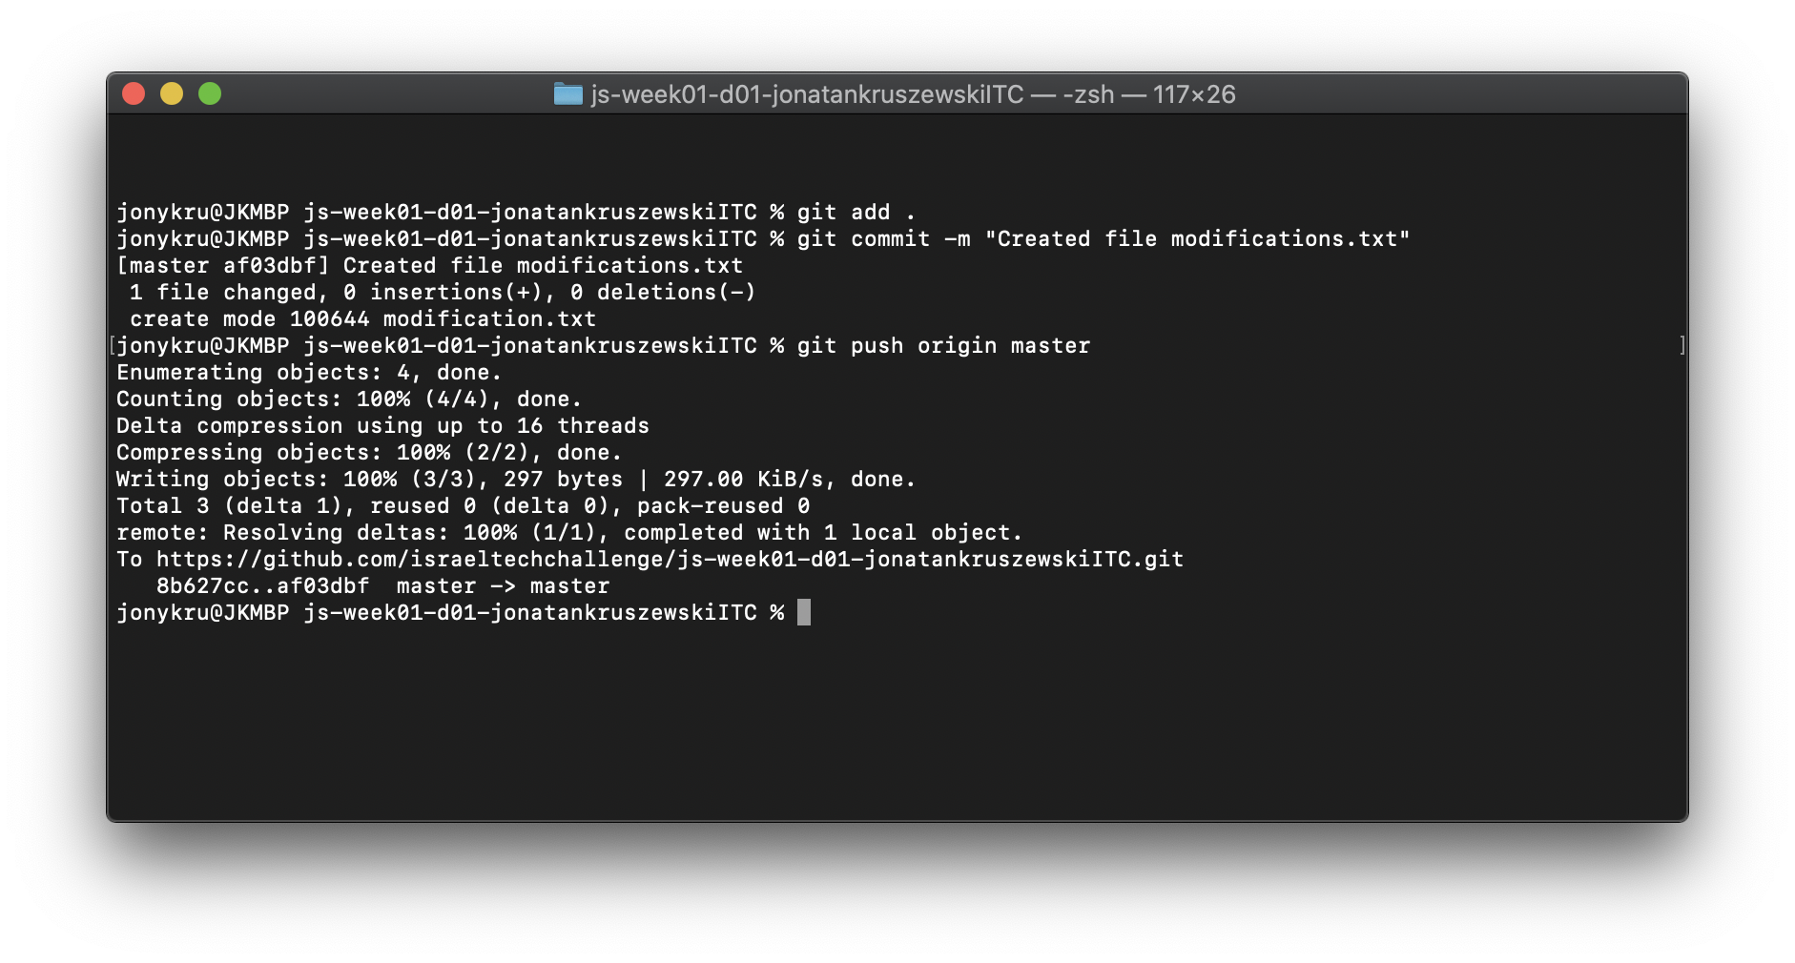
Committing and pushing
Remember to push often your code in small and organized commits!

